Slide 1
GeoNet Deep Geodesic Networks for Point Cloud Analysis
CVPR 2019

Slide 2
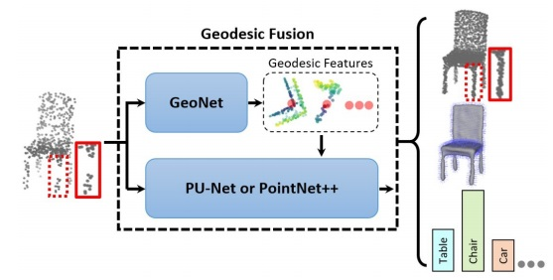
The two clusters of points, though seemingly disconnected, should indeed be connected to form a chair leg, which supports the whole chair.
On the other hand, the points on opposite sides of a chair seat, though spatially very close to each other,should not be connected to avoid confusing the sittable up-per surface with the unsittable lower side.

Slide 3
Introduction
Motivation
Main contributions
GeoNet
Geodesic Fusion
Experiments

Slide 4
Introduction
3D物体表面的拓扑结构往往能为分类，语义分割，模型重建等多种任务带来强大的特征。
这些拓扑学特征在已有的点云特征提取结构中往往丢失了。

Slide 5
Motivation
Develop representations of point cloud data that are informed by the underlying surface topology as well as object geometry
Propose methods that leverage the learned topological features for geodesic-aware point cloud analysis
Notes:
设计一种点云的升级版表示，这样的表示可以携带更多点云物体表面的拓扑学结构，这样的结构不仅不会改变点云的特性，还能帮助下游的任务更好的联合学习点云的特征

Slide 6
Main contributions
本文是点云相关深度学习任务中第一个提出去推断点云表面拓扑结构的工作
Develop network fusion architectures that incorporate GeoNet with baseline or back-bone networks for geodesic-aware point set analysis

Slide 7
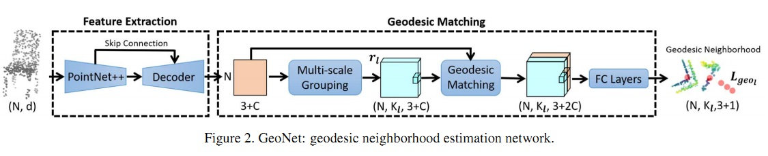
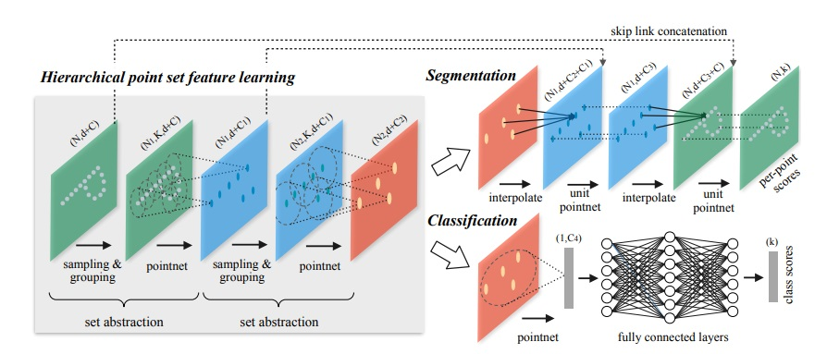
GeoNet

Slide 8
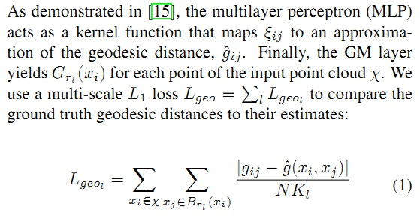
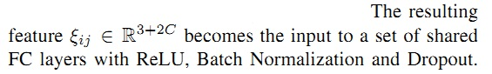

Notes:
geodesic distance：测地距离

Slide 9
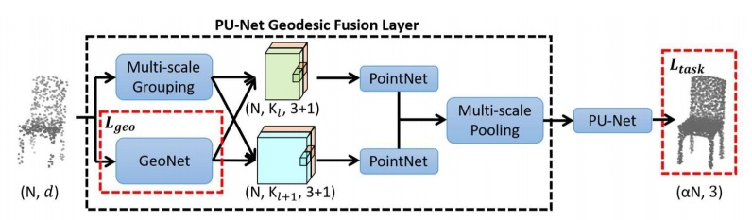


Geodesic Fusion
PU-Net Geodesic Fusion
Notes:
对于PU-Net来说，它相当于把学习测地距离的高维特征向量与点云通过MLP的特征向量进行了融合，并且计算两部分loss

Slide 10
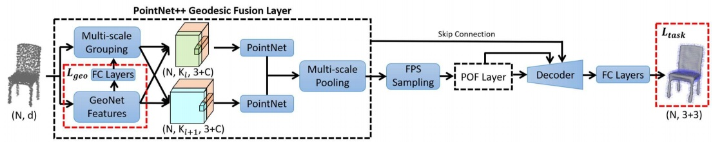
PointNet++ Geodesic Fusion
PointNet++ Geodesic Fusion
The total loss for POF also has two parts: One is for GeoNet training and the other is for the task-at-hand
Notes:
对于Pointnet++来说，其测地距离主要是用在了grouping&sampling的地方，当然也有高维特征的融合，详细的原理同样可以看

Slide 11
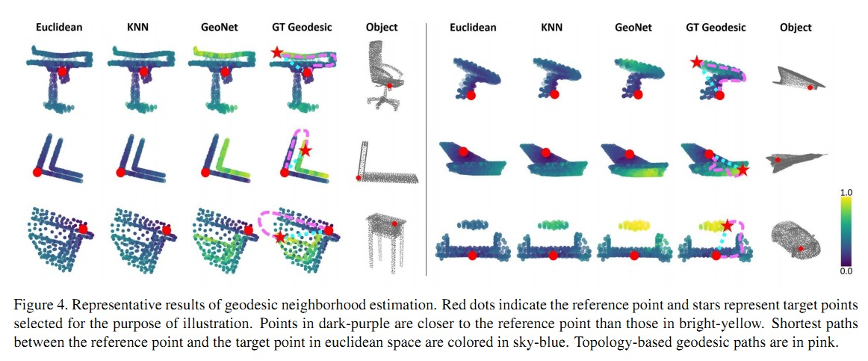
Experiments
Geodesic Neighborhood Estimation

Slide 12
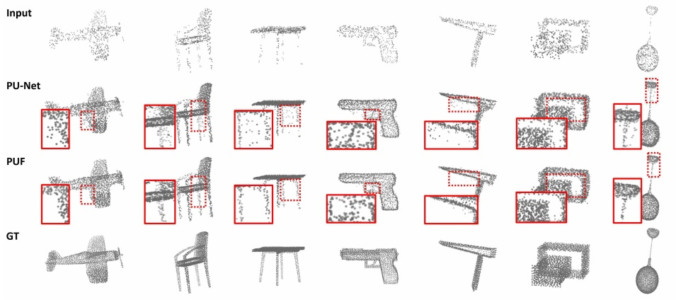
Point Cloud Upsampling

Slide 13
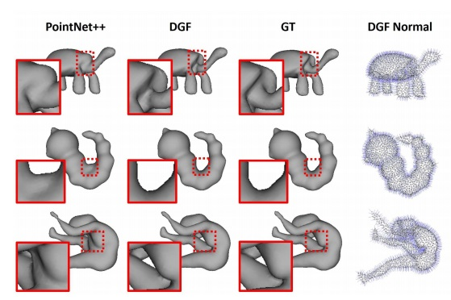
Normal Estimation and Mesh Reconstruction

Slide 14
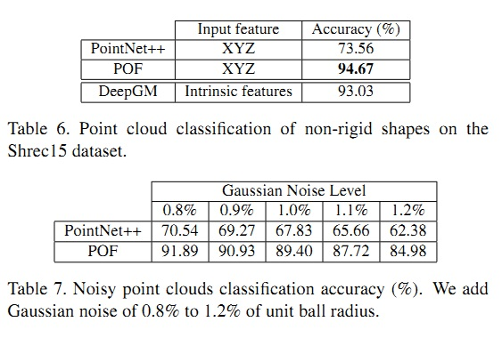
Non-regid Shape Classification

